Slide 1



Noida Institute of Engineering and Technology, Greater Noida
Digital Innovation and trends
Unit: 5
DIGITAL MARKETING
Nishu chauhan
MBA Department
B.Tech CSE Semester VI

Slide 2

Index/Content
S. No. | Index
1. | Name of Subject with code, Course and Subject Teacher
2. | Brief Introduction of Faculty member with Photograph
3. | Evaluation Scheme
4. | Syllabus
5. | Branch wise Application
6. | Course Objective(s)
7. | Course Outcome(s)
8. | Program Outcomes (POs)
9. | COs and POs Mapping

Slide 3
Index/Content
S. No. | Index
10. | Program Specific Outcomes (PSOs)
11. | Cos and PSOs Mapping
12. | Program Educational Objectives (PEOs)
13. | Result Analysis
14. | End Semester Question paper Templates
15. | Prequisite/Recap
16. | Brief Indtroduction about the Subject with Videos
17. | Unit Contents
18. | Unit Objectives
19. | Topic Objectives/Topic Outcome

Slide 4
Index/Content
S. No. | Index
20. | Lecture related to topic
21. | Daily Quiz
22. | Weekly Assignment
23. | Topic Links
24. | MCQs
25. | Glossary Questions
26. | Old question papers
27. | Expected Questions
28. | Recap of unit

Slide 5
Faculty Profile
Faculty Name: Nishu Chauhan
Designation: Assistant Professor
Department: School Of Management
Email ID : nishu.chauhan@niet.co.in
Qualification: BBA, MBA, Pursuing PhD
Specialisation: HR & Marketing
Teaching Area: Marketing & HR

Slide 6
Evaluation scheme

Slide 7

Syllabus
UNIT-I | Introduction to Digital Marketing | Hours- 8
Introduction to Digital Marketing: Concept of Marketing, the new digital world - trends that are driving shifts from traditional marketing practices to digital marketing practices, the modern digital consumer and new consumer’s digital journey. Marketing strategies for the digital world-latest practices.
UNIT-II | Social Media Marketing | Hours-8
Introduction to Blogging, Create a blog post for your project. Include headline, imagery, links and post, Content Planning and writing. Introduction to Face book, Twitter, Google +, LinkedIn, YouTube, Instagram and Pinterest; their channel advertising and campaigns
UNIT-III | Acquiring & Engaging Users through Digital Channels | Hours-8
Understanding the relationship between content and branding and its impact on sales, search engine marketing, overview of search engine optimization (SEO), mobile marketing, video marketing, and social-media marketing. Marketing gamification, marketing analytic tools to segment, target and position.

Slide 8
Syllabus
UNIT-IV | Designing Organization for Digital Success | Hours-8
Digital transformation, digital leadership principles, online P.R. and reputation management. ROI of digital strategies, how digital marketing is adding value to business, and evaluating cost effectiveness of digital strategies
UNIT-V | Digital Innovation and Trends |  | Hours-8
The contemporary digital revolution, digital transformation framework; security and privatization issues with digital marketing Understanding trends in digital marketing – Indian and global context, online communities and co-creation.

Slide 9
Applications
With the advent of new technologies, the field of Marketing has seen a paradigm shift over the years.
Though it is still in use, businesses across the world have switched from traditional modes of marketing to digital marketing.
This, in turn, has created many new opportunities for companies to expand their business and has created tremendous employment opportunities across sectors.
From Content curation and management to Social Media Marketing and Brand Management, a career in Digital Marketing can take you in several directions.
Top Job Profiles: Digital Marketing Manager, Social Media Manager, Content Writer, Data and Market Analytics Manager

Slide 10
Course Objectives
1 | Provide understanding of digital and social media marketing practices.
2 | Provide understanding of different social media platforms
3 | Impart learning on various digital channels and how to acquire and engage consumers online.
4 | Provide insights on building organizational competency by way of digital marketing practices and cost considerations.
5 | Develop understanding of the latest digital practices for marketing and promotion.

Slide 11
Course Outcomes
CO 1 | Develop an understanding of digital and social media marketing practices. | Knowledge (K2), Remembering (K1)
CO 2 | Develop understanding of the social media platforms | Comprehending (K 3)
CO 3 | Acquire the skill to acquire and engage consumers online | Knowledge (K2), Applying (K4)
CO 4 | Develop understanding of building organizational competency by way of digital marketing practices and cost considerations | Knowledge (K2), Analyzing (K5)
CO 5 | Develop understanding of the latest digital practices for marketing and promotion. | Knowledge (K2), Applying (K4)

Slide 12
Program Outcomes
PO1: Apply Knowledge of Management theories and practices
PO2: Foster Analytical & Critical thinking abilities
PO3: Develop Value based leadership
PO4: Understand, analyze and communicate all aspects of business
PO5: Achievement of Organizational goals

Slide 13
CO-PO Mapping
S No | CO/PO | PO1 | PO2 | PO3 | PO4 | PO5
1 | CO1 | 2 |  |  | 3 | 2
2 | CO2 |  |  |  | 3 | 2
3 | CO3 | 1 | 2 | 2 | 2 | 3
4 | CO4 |  | 3 | 2 | 3 | 2
5 | CO5 |  | 2 | 2 | 2 | 3
 | Avg | 0.6 | 1.4 | 1.2 | 2.6 | 2.4
High=3,Medium =2 ,Low=1

Slide 14
Program Educational Objectives
PEO 1: To have an excellent scientific and engineering breadth so as to comprehend, analyze, design and provide sustainable solutions for real-life problems using state-of-the-art technologies.
PEO 2: To have a successful career in industries, to pursue higher studies or to support entrepreneurial endeavors and to face the global challenges.
PEO 3: To have effective communication skills, professional attitude, ethical values and a desire to learn specific knowledge in emerging trends, technologies for research, innovation and product development and contribution to society.
PEO 4: To have life-long learning for up-skilling and re-skilling for a successful professional career as an engineer, scientist, entrepreneur or bureaucrat for the betterment of the society.

Slide 15
Program Specific Objectives
The ability to identify, analyze real world problems and design their ethical solutions using artificial intelligence, robotics, virtual/augmented reality, data analytics, block chain technology, and cloud computing.
The ability to design and develop the hardware sensor devices and related interfacing software systems for solving complex engineering problems.
The ability to understand inter-disciplinary computing techniques and to apply them in the design of advanced computing.
The ability to conduct investigation of complex problems with the help of technical, managerial, leadership qualities, and modern engineering tools provided by industry-sponsored laboratories.

Slide 16
Result Analysis
Subject Name & Code | Total No. Of Students | Pass % | 40>65 (%) | 65>75 (%) | 75>90 (%) | 90 & Above (%) | Backlog | Average Marks

Slide 17
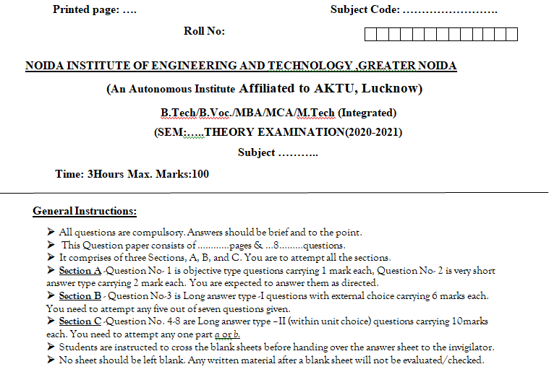
End Semester Question Paper Template

Slide 18
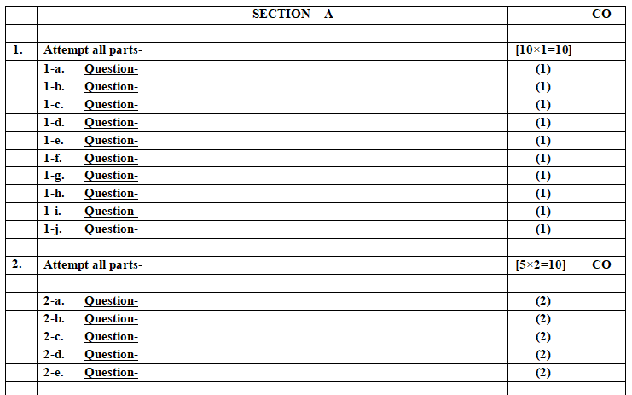
End Semester Question Paper Template

Slide 19
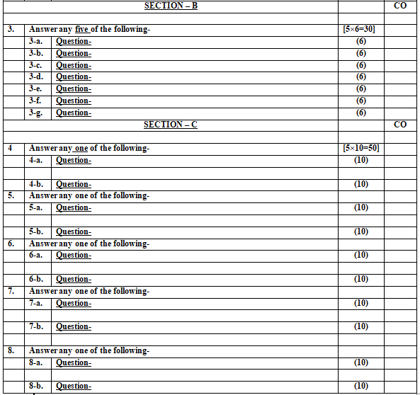
End Semester Question Paper Template

Slide 20
Prerequisite and Recap
Student should have a general understanding of:
1.Security issues in digital Marketing
2.Digital transformation Frame work
3. Emerging trends in digital marketing in India

Slide 21
Introduction of the subject
The course is designed to make learner conversant with Digital Marketing and proficient in Social Media tools and techniques starting from the fundamentals of digital marketing.
Social media websites and applications allow users to create and exchange user-generated content where people talk, share information, participate and network through technologies such as blogs and social networking sites.
Within the last decade, social media has become one of the most powerful sources for news updates, online collaboration, networking, viral marketing and entertainment.
https://www.youtube.com/watch?v=Xuq6_udbeH0&list=PLi3oNa09iwJRByiNwEJNaZ3XVKcveovzk
https://www.youtube.com/watch?v=X-pCbWwu50k

Slide 22
Content
The contemporary digital revolution(CO5)
Digital Transformation Framework (CO5)
Security and privatization issues with digital marketing (CO5)
Understanding trends in digital marketing– Indian and global context(CO5)
Online communities and co-creation (CO5)

Slide 23
Objectives of Unit
To make the students understand the digital revolution
To explain the security and privatization issues with digital marketing
To make the students aware of the recent global trends in digital marketing
To develop an understand on co-creation and Online Communities

Slide 24

Noida Institute of Engineering and Technology, Greater Noida
(Unit –V) Topic 1
The contemporary digital revolution

Slide 25
Objectives of Topics /Session
Students will learn about the Contemporary digital revolution

Slide 26
The Digital Revolution(CO5)
The Digital Revolution refers to the advancement of technology from analog, electronic and mechanical devices to the digital technology available today. The era started during the 1980s and is ongoing.
The Digital Revolution also marks the beginning of the Information Era.
From analogous to the Agricultural Revolution and Industrial Revolution, the Digital Revolution marked the beginning of the Information Age
The Digital Revolution is sometimes also called the Third Industrial Revolution.
Notes:
It is the era of digital electronic equipment that started around the 1980s and is still continuing.

Slide 27
The Contemporary Digital Revolution(CO5)
The development and advancement of digital technologies started with one fundamental idea: The Internet. Here is a brief timeline of how the Digital Revolution progressed:
1947–1969: Origins
In 1947, the first working transistor, the germanium-based point-contact transistor, was invented by John Bardeen and Walter Houser Brattain while working under William Shockley at Bell Labs.

Slide 28
The Contemporary Digital Revolution(CO5)
Other important technological developments included the invention of the monolithic integrated circuit chip by Robert Noyce at Fairchild Semiconductor in 1959
The transistor, which was introduced in 1947, paved the way for the development of advanced digital computers. The government, military and other organizations made use of computer systems during the 1950s and 1960s.

Slide 29
The Contemporary Digital Revolution(CO5)
1969–1989: Invention of the Internet, rise of home computers
The public was first introduced to the concepts that led to the Internet when a message was sent over the ARPANET in 1969
1980s - The computer became a familiar machine and by the end of the decade, being able to use one became a necessity for many jobs. The first cellphone was also introduced during this decade.

Slide 30
The Contemporary Digital Revolution(CO5)
1989–2005: Invention of the World Wide Web, mainstreaming of the Internet, Web 1.0
The first public digital HDTV broadcast was of the 1990 World Cup that June; it was played in 10 theaters in Spain and Italy. However, HDTV did not become a standard until the mid-2000s outside Japan.
The World Wide Web became publicly accessible in 1991, which had been available only to government and universities.

Slide 31
The Contemporary Digital Revolution(CO5)
1990s - By 1992, the World Wide Web had been introduced, and by 1996 the Internet became a normal part of most business operations. By the late 1990s, the Internet became a part of everyday life for almost half of the American population.
2000s - By this decade, the Digital Revolution had begun to spread all over the developing world; mobile phones were commonly seen, the number of Internet users continued to grow, and the television started to transition from using analog to digital signals.

Slide 32
The Contemporary Digital Revolution(CO5)
2005–present: Web 2.0, social media, smartphones, digital TV
Luxembourg and the Netherlands became the first countries to completely transition from analog to digital television
2010 and beyond - By this decade, Internet makes up more than 25 percent of the world's population. Mobile communication has also become very important, as nearly 70 percent of the world's population owns a mobile phone. The connection between Internet websites and mobile gadgets has become a standard in communication.
By 2012, over 2 billion people used the Internet, twice the number using it in 2007. Cloud computing had entered the mainstream by the early 2010s.

Slide 33
The Contemporary Digital Revolution(CO5)
Web 1.0 | Web 2.0 | Web 3.0
Mostly Read-Only | Wildly Read-Write | Portable and Personal
Company Focus | Community Focus | Individual Focus
Home Pages | Blogs / Wikis | Live-streams / Waves
Owning Content | Sharing Content | Consolidating Content
WebForms | Web Applications | Smart Applications
Directories | Tagging | User Behaviour

Slide 34
The Digital Revolution during COVID -19(CO5)
Since the 1980s, the digital revolution has been both a negative and positive force. Within a few weeks of the Covid-19 outbreak, lockdown accelerated the adoption of digital solutions at an unprecedented pace, creating unforeseen opportunities for scaling up alternative approaches to social and economic life.
Notes:
The pandemic supported changes in data collection techniques and dissemination practices for official statistics, and how seemingly insuperable obstacles to the implementation of e-health treatments were largely overcome and how the ethics of artificial intelligence became a primary concern for government legislation at national and international levels, and how the features enabling smart cities to act as drivers of productivity did not necessarily give them an advantage during the pandemic.

Slide 35
The Digital Revolution during COVID -19(CO5)
At the micro-level, families are shown to have become ‘digital by default’, as children were exposed to online risks and opportunities. Globally, the spread of the pandemic provided a fertile ground for cybercrime, while digital disinformation and influencing risked becoming normalised and domesticated.
https://www.tandfonline.com/doi/full/10.1080/21582041.2020.1833234
https://www.researchgate.net/publication/345003827_Covid-19_and_the_digital_revolution

Slide 36
Daily Quiz
1. The _________refers to the advancement of technology from analog, electronic and mechanical devices to the digital technology available today.
2. The World Wide Web became publicly accessible in 1991. (True/ False)
3. Arpanet was the first real network to run on packet switching technology. (True/False)
4. By _______, the Digital Revolution had begun to spread all over the developing world

Slide 37
Noida Institute of Engineering and Technology, Greater Noida
(Unit –V) Topic 2
Digital Transformation Framework

Slide 38
Recap
The Digital Revolution is the shift from mechanical and analogue electronic technology to digital electronics which began in the later half of the 20th century, with the adoption and proliferation of digital computers and digital record-keeping, that continues to the present day.

Slide 39
Objectives of Topics /Session
Students will learn about the digital framework

Slide 40
Digital Transformation Framework(CO5)
The world is undergoing a digital transformation. This transformation will result in an explosion in digital data and more importantly, usable insight.
Other technologies like sensors, beacons, scanners, RFID (radio frequency identification), NFC (near field communications), GPS (global positioning systems), Bluetooth, web clicks, social media postings, digital newsfeeds, smart watches, fitness bands, video surveillance, drones, robotics, etc. are all contributing to the digitalization of our physical world.

Slide 41
Digital Transformation Framework(CO5)
A digital transformation framework is the blueprint for how an organization moves through a period of significant change because of the current evolving business conditions.
The framework is a tool, used across an organization, that guides all levels of the organization through the journey. It ensures that no area of the business is left unattended during the period of change.

Slide 42
Digital Transformation Framework(CO5)
It provides a common reference point that can be evolved as the organization changes – thus, the digital transformation framework is central to success.
The framework enables the strategy and roadmap that allows organizations, of all sizes, to evolve and success in the rapidly changing market conditions that now exist.

Slide 43
Need for Digital Transformation (CO5)
Companies are optimized for the environment where they already operate. When anything in that environment changes, be it quickly or over time, they are not equipped to adapt and changes.
Further, the external factors are driving disruption like– customer expectations, employee expectations, new technology, new business models and new, rapidly growing startups.
This is when digital transformation frameworks will help the leaders steer the organization back onto a path that propels the business forward, not backwards.
The reality is, it’s not the largest nor the most currently successful companies that succeed. Successful companies are the ones that are the most adaptable.

Slide 44
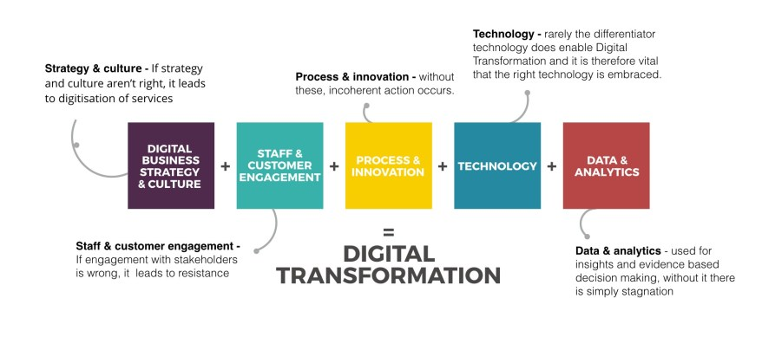
Digital Transformation Framework (CO5)

Slide 45
Benefits of a Digital Transformation Framework(CO5)
All organizations exist as a finely tuned mix of separate functions, working together to deliver products and services to customers.
The right digital transformation framework will provide scaffolding to guide the organization through the period of intense change.
It will ensure that no areas of the business are misunderstood or left behind in the process.
It will provide a way to create tangible benchmarks, meaningful metrics and, clear indications of progress and, areas where more attention is required.

Slide 46
Daily Quiz
1. A ________ framework is the blueprint for how an organisation moves through a period of significant change in the current evolving business conditions.
2. Explain the role of technology during the time of crises.
3. Name the 5 elements in digital Transformation framework.
4. State one benefit of Digital transformation.

Slide 47
Noida Institute of Engineering and Technology, Greater Noida
(Unit –V) Topic 3
Security Issue with Digital Marketing

Slide 48
Recap
The digital transformation framework is a tool, used across an organization, that guides all levels of the organization through the journey. It ensures that no area of the business is left unattended during the period of change.

Slide 49
Topic Objectives
1. To make the students aware about the security issues with digital marketing.
2. To explain the different provisions for the security of data in digital transactions.

Slide 50
Security Issue with Digital Marketing(CO5)
What is information security?
Ensuring your website is available 24 hours a day for your customers
Ensuring only the correct people can administer the website’s content
Preventing un authorised alteration or destruction of your data
Avoiding your website being used to distribute other peoples’ software
Ensuring that your employees cannot accidentally delete valuable information
Stopping your website being used to damage users’ computers
Protecting your reputation

Slide 51
Types of Security Risks (CO5)
Hacking
Destruction of Data - viruses
Malware
Phishing
Secure Payments/Website Encryption

Slide 52
Hacking (CO5)
Hacking is an attempt to exploit a computer system or a private network inside a computer. Simply put, it is the unauthorised access to or control over computer network security systems for some illicit purpose.
White hat professionals hack to check their own security systems to make it more hack-proof. In most cases, they are part of the same organisation.
Black hat hackers hack to take control over the system for personal gains. They can destroy, steal or even prevent authorized users from accessing the system.

Slide 53
Hacking (CO5)
Grey hat hackers comprise curious people who have just about enough computer language skills to enable them to hack a system to locate potential loopholes in the network security system.
Grey hats differ from white hats in the sense that the former notify the admin of the network system about the weaknesses discovered in the system, whereas the latter is only looking for personal gains.

Slide 54
Malware (CO5)
Malware is a catch-all term for any type of malicious software designed to harm or exploit any programmable device, service or network. Cybercriminals typically use it to extract data that they can leverage over victims for financial gain.
Malware (a portmanteau for malicious software) is any software intentionally designed to cause damage to a computer, server, client, or computer network (by contrast, software that causes unintentional harm due to some deficiency is typically described as a software bug). A wide variety of malware types exist, including computer viruses, worms, Trojan horses, ransomware, spyware, adware, rogue software, wiper and scareware

Slide 55
Malware (CO5)
Malware encompasses all types of malicious software, including viruses, and cybercriminals use it for many reasons, such as:
Tricking a victim into providing personal data for identity theft
Stealing consumer credit card data or other financial data
Assuming control of multiple computers to launch denial-of-service attacks against other networks
Infecting computers and using them to mine bitcoin or other cryptocurrencies

Slide 56
Types of Malware (CO5)
Viruses
A virus usually comes as an attachment in an email that holds a virus payload, or the part of the malware that performs the malicious action. Once the victim opens the file, the device is infected.
Ransomware
One of the most profitable, and therefore one of the most popular, types of malware amongst cybercriminals is ransomware. This malware installs itself onto a victim’s machine, encrypts their files, and then turns around and demands a ransom (usually in Bitcoin) to return that data to the user.

Slide 57
Types of Malware (CO5)
Scareware
Cybercriminals scare us into thinking that our computers or smartphones have become infected to convince victims to purchase a fake application. In a typical scareware scam, you might see an alarming message while browsing the Web that says “Warning: Your computer is infected!” or “You have a virus!” Cybercriminals use these programs and unethical advertising practices to frighten users into purchasing rogue applications.
Worms
Worms have the ability to copy themselves from machine to machine, usually by exploiting some sort of security weakness in a software or operating system and don’t require user interaction to function.

Slide 58
Types of Malware (CO5)
Spyware
Spyware is a program installed on your computer, usually without your explicit knowledge, that captures and transmits personal information or Internet browsing habits and details to its user. Spyware enables its users to monitor all forms of communications on the targeted device.
Trojans
Trojans masquerade as harmless applications, tricking users into downloading and using them. Once up and running, they then can steal personal data, crash a device, spy on activities or even launch an attack.
Notes:
Spyware is often used by law enforcement, government agencies and information security organizations to test and monitor communications in a sensitive environment or in an investigation. But spyware is also available to consumers, allowing purchasers to spy on their spouse, children and employees.

Slide 59
Types of Malware (CO5)
Adware
Adware programs push unwanted advertisements at users and typically display blinking advertisements or pop-up windows when you perform a certain action. Adware programs are often installed in exchange for another service, such as the right to use a program without paying for it.
Fileless malware
Fileless malware is a type of malicious software that uses legitimate programs to infect a computer. Fileless malware registry attacks leave no malware files to scan and no malicious processes to detect. It does not rely on files and leaves no footprint, making it challenging to detect and remove.

Slide 60
Phishing (CO5)
Phishing is a cybercrime in which a target or targets are contacted by email, telephone or text message by someone posing as a legitimate institution to lure individuals into providing sensitive data such as personally identifiable information, banking and credit card details, and passwords.
The information is then used to access important accounts and can result in identity theft and financial loss.

Slide 61
Phishing (CO5)
Too Good To Be True - Lucrative offers and eye-catching or attention-grabbing statements are designed to attract people’s attention immediately. For instance, many claim that you have won an iPhone, a lottery, or some other lavish prize. Just don't click on any suspicious emails. Remember that if it seems to good to be true, it probably is!

Slide 62
Phishing (CO5)
Sense of Urgency - A favorite tactic amongst cybercriminals is to ask you to act fast because the super deals are only for a limited time. Some of them will even tell you that you have only a few minutes to respond. When you come across these kinds of emails, it's best to just ignore them. Sometimes, they will tell you that your account will be suspended unless you update your personal details immediately

Slide 63
Phishing (CO5)
Hyperlinks - A link may not be all it appears to be. Hovering over a link shows you the actual URL where you will be directed upon clicking on it. It could be completely different or it could be a popular website with a misspelling, for instance www.bankofarnerica.com - the 'm' is actually an 'r' and an 'n', so look carefully.
Attachments - If you see an attachment in an email you weren't expecting or that doesn't make sense, don't open it!

Slide 64
Prevention against Phishing (CO5)
To protect against spam mails, spam filters can be used. Generally, the filters assess the origin of the message, the software used to send the message, and the appearance of the message to determine if it’s spam. Occasionally, spam filters may even block emails from legitimate sources, so it isn’t always 100% accurate.

Slide 65
Prevention against Phishing (CO5)
The browser settings should be changed to prevent fraudulent websites from opening. Browsers keep a list of fake websites and when you try to access the website, the address is blocked or an alert message is shown. The settings of the browser should only allow reliable websites to open up.
One way to ensure security is to change passwords on a regular basis, and never use the same password for multiple accounts. It’s also a good idea for websites to use a CAPTCHA system for added security.

Slide 66
Prevention against Phishing (CO5)
Banks and financial organizations use monitoring systems to prevent phishing. Individuals can report phishing to industry groups where legal actions can be taken against these fraudulent websites.
Organizations should provide security awareness training to employees to recognize the risks.
Changes in browsing habits are required to prevent phishing. If verification is required, always contact the company personally before entering any details online.
If there is a link in an email, hover over the URL first. Secure websites with a valid Secure Socket Layer (SSL) certificate begin with “https”. Eventually all sites will be required to have a valid SSL.

Slide 67
Encryption (CO5)
Encryption is the method by which information is converted into secret code that hides the information's true meaning. The science of encrypting and decrypting information is called cryptography.
In computing, unencrypted data is also known as plaintext, and encrypted data is called ciphertext. The formulas used to encode and decode messages are called encryption algorithms, or ciphers.

Slide 68
Encryption (CO5)
SSL (Secure Sockets Layer) and its successor, TLS (Transport Layer Security), are protocols for establishing authenticated and encrypted links between networked computers.
A website that implements SSL/TLS has "HTTPS" in its URL instead of "HTTP.

Slide 69
Encryption (CO5)
In order to provide a high degree of privacy, SSL encrypts data that is transmitted across the web. This means that anyone who tries to intercept this data will only see a garbled mix of characters that is nearly impossible to decrypt.
SSL initiates an authentication process called a handshake between two communicating devices to ensure that both devices are really who they claim to be.

Slide 70
Encryption (CO5)
Importance of encryption
Encryption plays an important role in securing many different types of information technology (IT) assets. It provides the following:
Confidentiality encodes the message's content.
Authentication verifies the origin of a message.
Integrity proves the contents of a message have not been changed since it was sent.
Nonrepudiation prevents senders from denying they sent the encrypted message.

Slide 71
Encryption (CO5)
How is it used?
Encryption is commonly used to protect data in transit and data at rest. Every time someone uses an ATM or buys something online with a smartphone, encryption is used to protect the information being relayed. Businesses are increasingly relying on encryption to protect applications and sensitive information from reputational damage when there is a data breach.

Slide 72
Firewall (CO5)
A Firewall is a network security device that monitors and filters incoming and outgoing network traffic based on an organization’s previously established security policies.
At its most basic, a firewall is essentially the barrier that sits between a private internal network and the public Internet. A firewall’s main purpose is to allow non-threatening traffic in and to keep dangerous traffic out.
A firewall is a network security device that monitors incoming and outgoing network traffic and decides whether to allow or block specific traffic based on a defined set of security rules.
Firewalls have been a first line of defense in network security for over 25 years. They establish a barrier between secured and controlled internal networks that can be trusted and untrusted outside networks, such as the Internet.
A firewall can be hardware, software, or both.

Slide 73
Managerial Preventative Measures (CO5)
Secure website design from the beginning – difficult/expensive to add later
Antivirus software is always up to date
Firewalls
Phishing notifications via email
Employee email filtering
Securesign SSL/TLS Certificates

Slide 74
Security Issue with Digital Marketing(CO5)
Consumer Concerns
Data leakage – how secure is my data and what happens if it is lost/leaked?
Data use without consent
Annoyance/Waste of time
Not having opt in/opt out notices
https://www.youtube.com/watch?v=inWWhr5tnEA

Slide 75
India’s regulatory mechanism for data protection and privacy(CO5)
India’s regulatory mechanism for data protection and privacy is the Information Technology Act, 2000 (“the IT Act”) and its corresponding Information Technology (Reasonable Security Practices and Procedures and Sensitive Personal Data or Information) Rules, 2011 (“the IT Rules”).
In addition to this, personal data is also protected under Article 21 of the Indian Constitution which guarantees to every citizen, the Right to Privacy as a fundamental right .
The Supreme Court has held in a number of cases that information about a person and the right to access that information by that person is also covered within the ambit of right to privacy.

Slide 76
India’s regulatory mechanism for data protection and privacy(CO5)
Section 43A of the IT Act creates a liability on a body corporate (including a firm, sole proprietorship or other association of individuals engaged in commercial or professional activities) which possesses, deals or handles any sensitive personal data or information in a computer resource that it owns, controls or operates to pay damages by way of compensation, to the person affected if there is any wrongful loss or wrongful gain to any person caused because of the negligence in implementing and maintaining reasonable security practices and procedures to protect the information of the person affected.

Slide 77
India’s regulatory mechanism for data protection and privacy(CO5)
Section 72 A of the IT Act mentions that any person (including an intermediary) who, while providing services under the terms of a lawful contract, has secured access to any material containing personal information about another person, with the intent of causing or knowing that he is likely to cause wrongful loss or wrongful gain discloses, without the consent of the person concerned, or in breach of a lawful contract, such material to any other person, shall be punished with imprisonment for a term which may extend to three years, or with fine which may extend to five lakh rupees, or with both.

Slide 78
Daily Quiz
1. Name any 2 types of Security risks.
2. Why is information security important?
3. Different type of Hacking are ___________.
4. Consumer concern related to Security is ________.
5. ________ is commonly used to protect data in transit and data at rest.

Slide 79
Noida Institute of Engineering and Technology, Greater Noida
(Unit –V) Topic 4
Trends in Digital Marketing: Online Communities & Co-Creation

Slide 80
Recap
Threats to customers' data privacy
Data security through anti-virus, firewalls and encryption, including keeping operating systems and backups up to date.
Hardware and network monitoring as well as mobile security consciousness.
Employee security education and monitoring

Slide 81
Topic Objectives
1. To make the students aware about the latest trends in digital marketing.
2. To draw insights into the latest trends in Indian Context.
3. To explain the concept of Online Communities and co-creation

Slide 82
Trends in Digital Marketing in Indian Context(CO5)
Search Engine Optimization (SEO)
Search Engine Marketing (SEM)
Content Creation
Social Media Marketing (SMM)
Digital Display Advertising
Retargeting and Remarketing
Mobile Marketing
Interactive Marketing
Viral Marketing
Digital Media Planning and Buying

Slide 83
Trends in Digital Marketing in 2021 (CO5)
1. No-Click Searches also Known as Featured Snippet
2. Google Verified Listings for Local SEO
3. Voice Search
4. Visual Search
5. Online Reviews
6. Automated & Smart Bidding in Google Ads
7. Interactive Content
8. Shoppable Posts
9. Social Media Messaging Apps
10. Social Media Stories

Slide 84
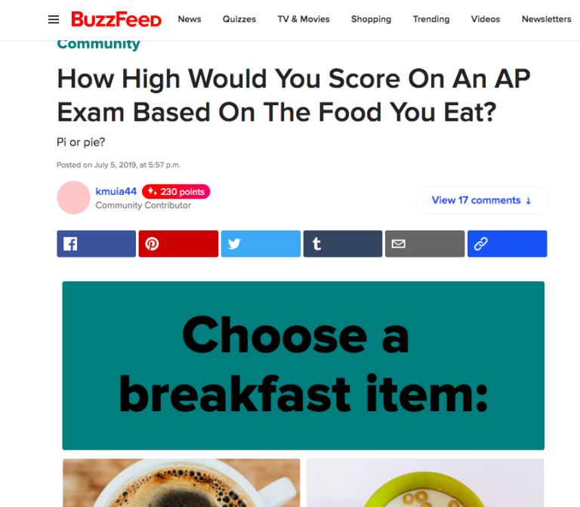
Interactive Content

Slide 85
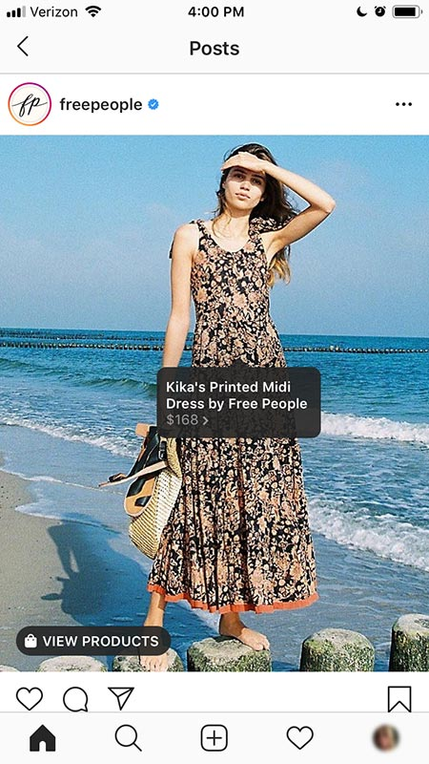
Shoppable posts (CO5)

Slide 86
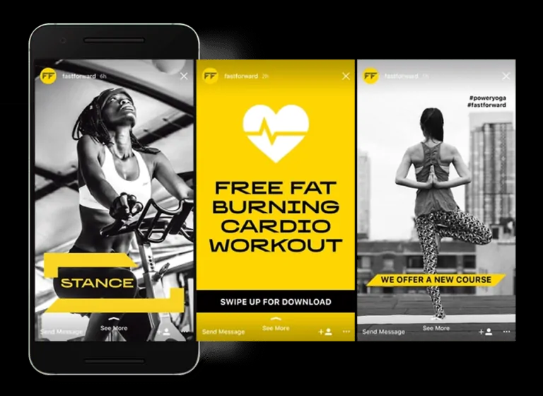
Social Media Stories (CO5)

Slide 87

Social Media Contests (CO5)

Slide 88
Online Communities (CO5)
An online community, also called an internet community, is a virtual community whose members interact with each other primarily via the Internet.
An online community or internet community is a group of people with a shared interest or purpose who use the internet to communicate with each other. Online communities have their own set of guidelines and needs, like online community engagement, moderation, and management.

Slide 89
Online Communities (CO5)
An online community can act as an information system where members can post, comment on discussions, give advice or collaborate. Commonly, people communicate through social networking sites, chat rooms, forums, e-mail lists and discussion boards. People may also join online communities through video games, blogs and virtual worlds.
A branded online community is a professional network to bring people together around a centralized, shared organization-based experience or purpose for expansive online collaboration and growth.
The type of community we’re talking about here is one that your organization would build online to connect your members, customers, employees, partners – whoever the community’s members might be.

Slide 90
Online Communities examples (CO5)
An increasing number of brands are building their own online communities in India, as they seek to engage members of the country's growing internet audience.
Samsung Mobile was one of the first major advertisers to take such an approach in the rapidly-developing economy, having launched the Samsung Fun Club in 2004.
This site, which now has more than three million users in India, offers a range of exclusive ringtones, games and videos, and the company plans to extend this range of services going forward.

Slide 91
Online Communities examples (CO5)
Canon, the camera specialist, has also registered some 80,000 members for Canon Edge, which contains a forum, blog, and hosts a range of competitions. "Since a lot of consumers participating in our community are interested in serious photography, this translated into nearly 100% growth in the digital SLR camera business," said Alok Bharadwaj, senior vice president of Canon India.

Slide 92
Online Communities (CO5)
LG Electronics, one of the biggest firms in its category in the Asian nation, is also in the process of establishing this kind of offering, according to L K Gupta, its chief marketing officer.
Tata Teleservices, the telecoms arm of one of the country's biggest conglomerates, is using its branded "Forum" to track popular preferences relating to Tata Indicom, Photon and Tata Docomo.
Philips, the electronics group, is aiming to tailor this sort of strategy to focus on business-to-business audiences, including experts in the lighting and healthcare industries.
https://www.youtube.com/watch?v=nXau5K10GkU

Slide 93
Online Communities (CO5)
4 types of online communities and the top benefits of each
Social communities
Support communities
Advocate communities
Insight communities

Slide 94
Social Communities (CO5)
Social communities include public social networks like Facebook, Twitter and Instagram.
Brands use social communities mostly for marketing purposes, broadcasting information, building brand awareness and reaching greater audiences for campaigns and messaging.
Social communities are useful for tracking what your competitors are up to and identifying broad consumer trends. Ninety-three percent of large companies use Facebook, according to a 2015 Social Media Examiner report.

Slide 95
Support Communities (CO5)
Support communities enable members to offer product tips to other customers, helping companies reduce customer support costs.
Compared to social communities, this category provides a more structured way of gathering innovative ideas because support communities allow brands to track product- and service-related conversations.
According to a 2015 Forrester Research report, 81 percent of companies have a support community of some kind.

Slide 96
Advocate Communities (CO5)
Advocate communities allow brands to mobilize their most passionate, loyal customers.
Also known as advocate marketing software, this community type often rewards members for writing a testimonial, posting about the company on social media and doing other similar activities.

Slide 97
Insight Communities (CO5)
Insight communities are made up of carefully selected groups of customers who maintain a long-term relationship with brands. These communities allow companies to gather continuous, high-quality feedback from engaged stakeholders like customers, partners or employees. Already a mainstream market research tool, this category is quickly finding its way in marketing, customer experience and innovation.

Slide 98
Co-creation(CO5)
Co-creation is a management initiative, or form of economic strategy, that brings different parties together (for instance, a company and a group of customers), in order to jointly produce a mutually valued outcome. Co-creation brings a blend of ideas from direct customers or viewers which in turn creates new ideas to the organization.
https://www.youtube.com/watch?v=VlD2EyW5W_k

Slide 99
Co-creation(CO5)
We define co-creation as the collaborative development of new value (concepts, solutions, products and services) together with experts and/or stakeholders (such as customers, suppliers etc.).
Co-creation is a form of collaborative innovation: ideas are shared and improved together, rather than kept to oneself. It is closely connected to – and mentioned alongside – two other buzz-words: ‘open source’ and ‘mass-customisation’.

Slide 100
Co-creation(CO5)
The concept of the 1% Rule is growing and developing. Some studies have found that 1% of the people in any society and community; they’re more creative and perform better in the group. Some companies have already launched the co-creation project to deal with the changing competitive world. But it’s still a new alien thing for many companies and businesses.

Slide 101
Process of Co-creation(CO5)
The process of co-creation essentially involves 2 core steps:
Contribution: Submission of contributions by the public to the firm
Selection: Selection of the most promising and appealing contributions/submissions.

Slide 102
Process of Co-creation(CO5)
In fact, many “old fashioned” research and development techniques - focus groups, surveys, and polls - are co-creation efforts in their own right.
But modern technology makes it easier to involve customers earlier in the process. Social media, internet forums, and online portals mean that co-creating can occur at every stage of the development process - from the initial idea, through to reviewing products once they hit the market.
Businesses need to find the most direct way to involve customers in product innovation. In many cases, the simplest solution is to build a web portal where users can suggest ideas, give feedback to one another, and stay connected to all co-creation projects.

Slide 103
Guiding Principles of Co-creation Strategy (CO5)
Inspire participation
You should challenge people to open up and share their thoughts. You have to make sure that the challenge should be intriguing and interesting. Most importantly, people would participate when you tell them what’s in it for them.
Once people start participating, now you have to create a favorable environment where they would feel comfortable and openly share their thoughts.

Slide 104
Guiding Principles of Co-creation Strategy (CO5)
Choose the best
You need the best talent of people to generate the best ideas. Your selected team may generate a lot of new ideas. The next stage is to evaluate the best idea out of many. You should have a keen eye to select an idea that has more potential for the company’s growth. You have to work with the best 1% of the creative people in order to achieve your goals.
For instance, Innocentive is a platform of scientists where researchers, experts, and scientists get together to solve difficult scientific issues. The platform has an impressive track record; it solves 30% of the problems.

Slide 105
Guiding Principles of Co-creation Strategy (CO5)
Connect with Innovative Minds
The goal of co-creation strategy would only complete when bright and creative minds work together. When you creating a team, make sure everyone should bring something different to the table. Your focus should be on unlocking the potential of everyone in the group, allowing open discussion, and positive criticism.
For instance, Lego decided to create a Mindstorm product with the ideas of users, instead of just creating it by themselves. The lead users and Lego developers have had a creatively competitive relationship, and they have become a part of the Lego product development community.

Slide 106
Guiding Principles of Co-creation Strategy (CO5)
Result Sharing
Co-creation could result in many forms like team insight, solving the problem, starting the new venture, and road mapping of the product. But there should be something in it for the contributors and participants. Therefore, you should give back something tangible, clear, and monetary.
For instance, Apple iPhone App Store invites developers to launch their user applications on the platform. 30% of the profit takes the stores, and the remaining 70% is for the application developers.

Slide 107
Guiding Principles of Co-creation Strategy (CO5)
Continuous Development
Co-creation would only deliver beneficial results when it works continuously over a period of time. The result of co-creation usually falls under the category of 20% to 80% of the completion. It requires a lot of polishing and development even after the delivery.
For instance, Procter & Gamble invites people from different fields to share their creative thoughts, and the company provides those resources and expertise.

Slide 108
Types of Co-creation(CO5)
Club of Experts
Club of experts is when a certain situation and specific challenge require the expertise and idea to solve it. If the participants have specific expertise, only then they would be able to contribute to it. The understanding and chemistry among team members define the success of the team.
For instance, Nokia develops a team of lead users and developers, and they work together to create something new.

Slide 109
Types of Co-creation(CO5)
The crowd of People/Crowdsourcing
The crowd of people is an open group where everyone could join and participate in the group. It follows the concept of the Rule of Big Number. It means that anyone who has a unique idea deserves an opportunity to participate. The online platform allows people to suggest, rate, and respond to their experiences.
For instance, Threadless is an e-commerce t-shirt platform, where designers share their designs and developer/users rate their feedback. The company shares 30% of the profit on the most sold and rated t-shirt items.

Slide 110
Types of Co-creation(CO5)
Coalition of Parties
A coalition of parties is when various expert parties collaborate to share investment and ideas.
Every member party brings some type of new skill and expertise to the table. When multiple parties team up to share resources, a new realization occurs.
For instance, Heineken started a co-creation partnership with Krups. They agree to work together for 10 years and the partnership resulted in the form of innovative packaging beer for a long time.

Slide 111
Types of Co-creation(CO5)
Community of Kindred Spirit
Community kindred spirit is when people collaborate to develop something of a greater good. The group usually involves people of similar interests.
For instance, developer users developed an open-source operating system, Linux. No one owns the operating system and it’s free for everyone.

Slide 112
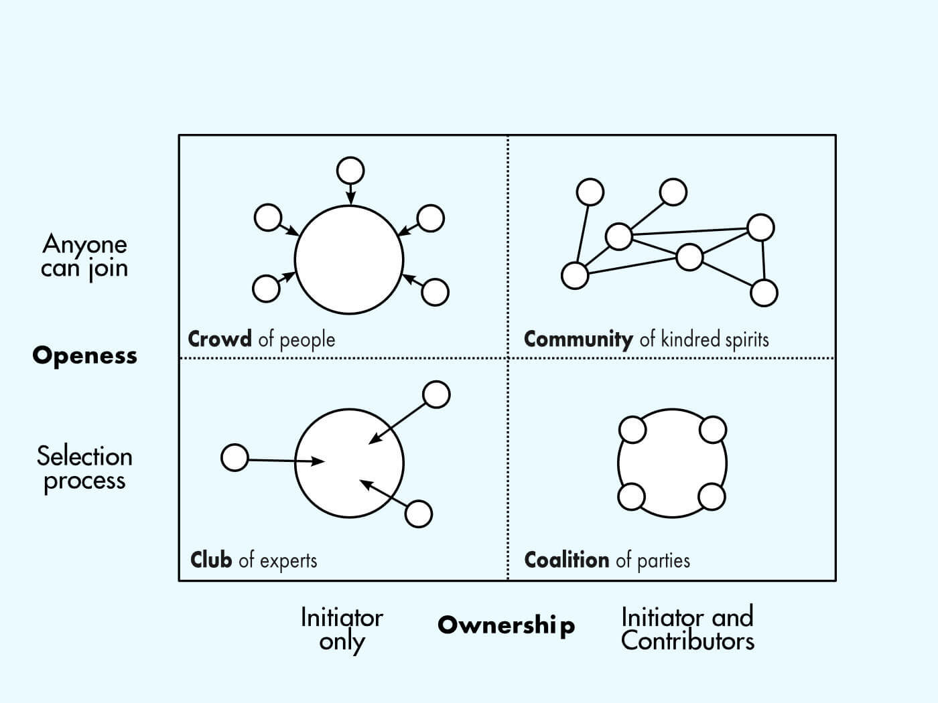
Types of Co-creation(CO5)

Slide 113
Types of Co-creation(CO5)
Tinkering: Public exercises control over the contribution activity while the firm exercises control over the selection activity
Submitting: Firm exercises complete control over both the activities
Co-designing: Firm exercises control over the contribution activity while the public exercises control over the selection activity
Collaborating: Public exercises complete control over both the activities

Slide 114
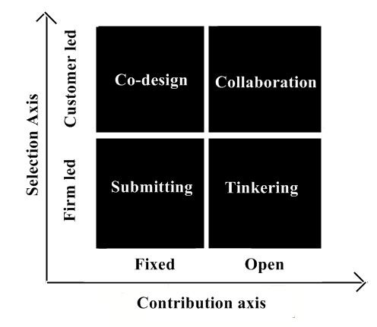
Types of Co-creation(CO5)

Slide 115
Examples of Co-creation(CO5)
Unilever
Unilever is the world’s leading consumer goods producing company. The brand is operating its business in over 190 countries worldwide. The company has over 400 brands under its umbrella. Unilever openly invites designers, academics, consumers, and many other people to give their suggestions on a certain challenge.
The challenge could be anything ranging from freezing, cooling system, oil oxidation technology, or something else. The owner of the good suggests would receive professional recognition and a commercial contract.

Slide 116
Examples of Co-creation(CO5)
DeWalt
Dewalt is the world’s leading power tool manufacturing company. The brand launched an insight community in 2015, where customers could share their product development ideas. The platform has thousands of users.
The company encourages customers’ engagement to discuss various ideas like website usability, design, packaging, and product development. The platform helps the company to develop better products.

Slide 117
Daily Quiz
https://forms.office.com/r/5NgxSPvTfJ
https://forms.office.com/r/A5A4iVQJLJ

Slide 118
Daily Quiz
1.Discuss the concepts of Interactive Content in marketing .
2.Discuss the different trends in digital marketing?
3.How Online Communities can be used in marketing?
4. Name any 2 Online communities.
5. Explain Co-Creation.

Slide 119
Assignment
Q1.Discuss digital transformation framework?
Q2.Highlight the importance of online communities in marketing ?
Q3.Explain the different ways which can be adopted by marketers to minimize security threats?
Q4. Define digital signature?
Q5.Explain what is app based marketing ?

Slide 120
Topic Links and Online Courses details
https://www.youtube.com/watch?v=VlD2EyW5W_k
https://www.youtube.com/watch?v=_zgSSeZJH30
https://www.youtube.com/watch?v=1sOEFGtcC5g
https://www.upgrad.com/management-emp-
https://www.mooc-list.com/tags/co-creation

Slide 121
MCQs
Which of the following is considered as the unsolicited commercial email?
Virus
Malware
Spam
All of the above
2. Which of the following usually observe each activity on the internet of the victim, gather all information in the background, and send it to someone else?
Malware
Spyware
Adware
All of the above
3. Which of the following refers to exploring the appropriate, ethical behaviors related to the online environment and digital media platform?
Cyber law
Cyber ethics
Cybersecurity
Cyber safety

Slide 122
MCQs
4. In system hacking, which of the following is the most crucial activity?
Information gathering
Covering tracks
Cracking passwords
None of the above
5. Code Red is a type of ________
An Antivirus Program
A photo editing software
A computer virus
A video editing software
6. Which of the following can be considered as the elements of cyber security?
Application Security
Operational Security
Network Security
All of the above

Slide 123
Glossary
i) Encryption ii) Phishing iii)Third Industrial Revolution iv) online community v) ) Black hat vi) Tinkering
The Digital Revolution is sometimes also called the ____________.
_______ hackers hack to take control over the system for personal gains.
______ is a cybercrime in which a target or targets are contacted by email, telephone or text message by someone posing as a legitimate institution.
A type of Co-creation in which public exercises control over the contribution activity while the firm exercises control over the selection activity is ________.
_______ is the method by which information is converted into secret code that hides the information's true meaning
________ is a virtual community whose members interact with each other primarily via the Internet.

Slide 124
Sessional Question paper (Online)
Objective Paper https://forms.office.com/r/kNi2FiFC0f
Subjective Paper
https://forms.office.com/r/h8K7Auphdm

Slide 125
Sessional Question paper

Slide 126
Sessional Question paper

Slide 127
Sessional Question paper

Slide 128
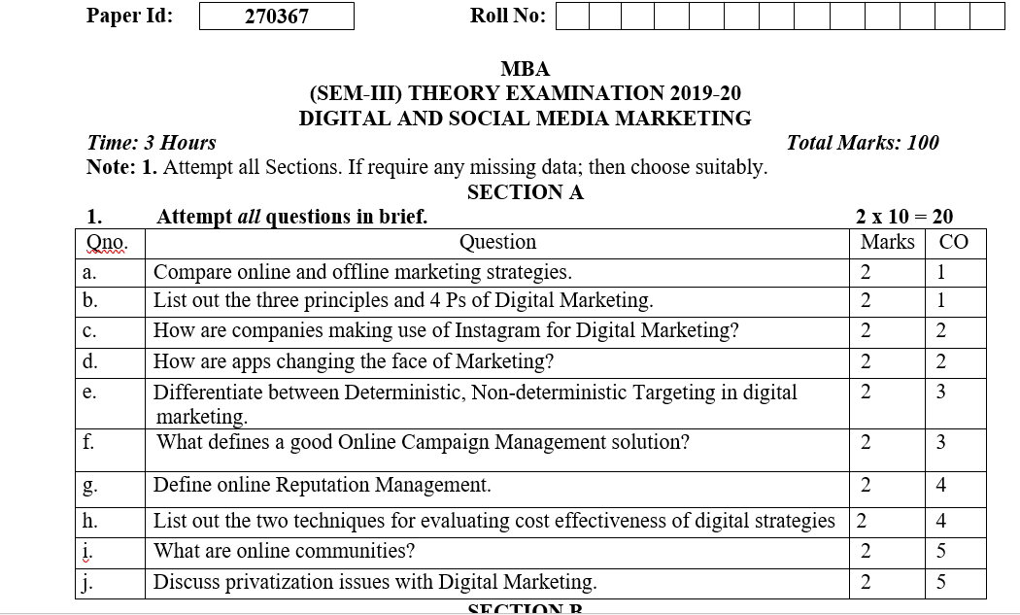
End Semester Question paper

Slide 129
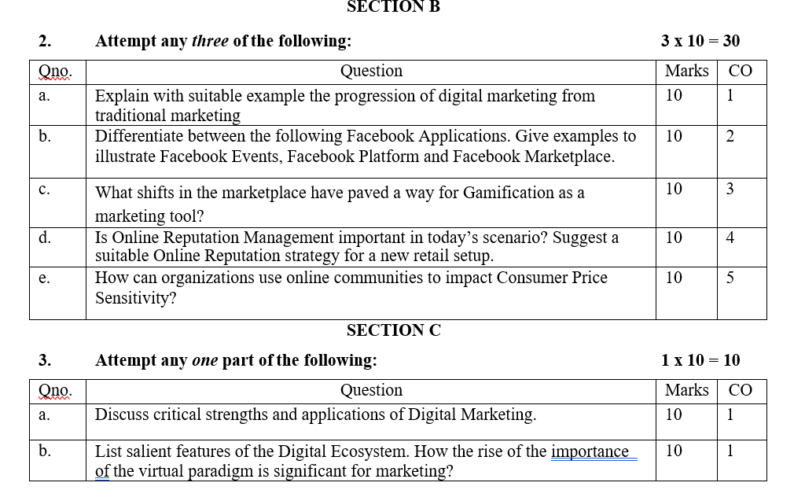
End Semester Question paper

Slide 130
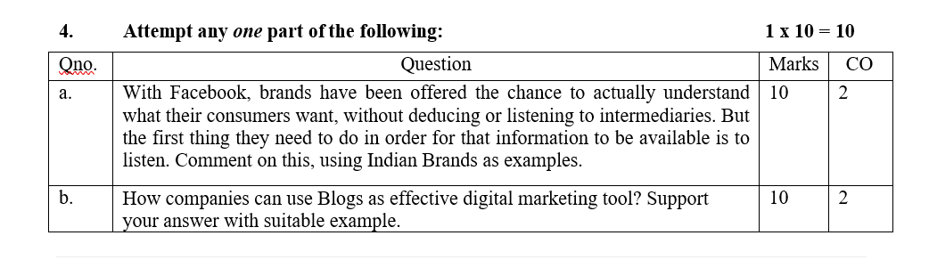
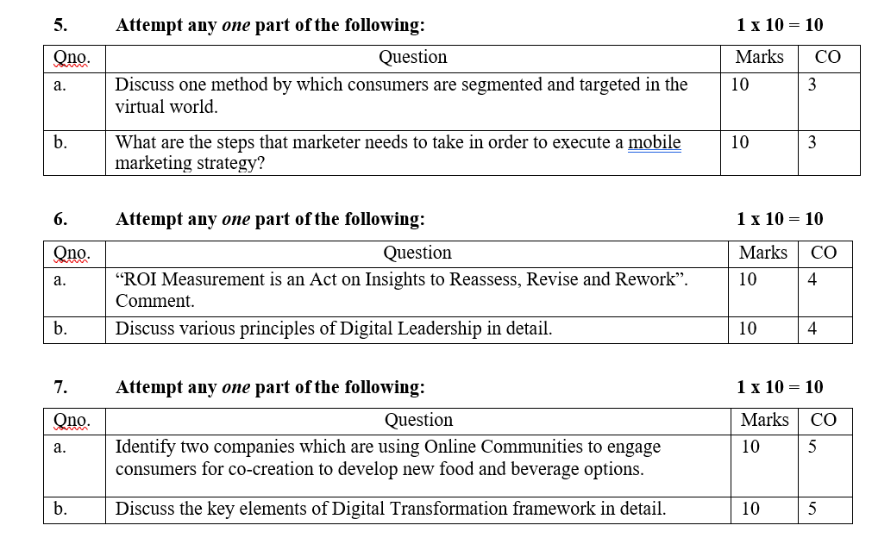
End Semester Question paper

Slide 131
Expected questions for University Exams
Q1. Discuss what does digital transformation really mean for today’s business leaders?
Q2. Explain the concept of digital innovation in marketing .Discuss digital transformation framework ?
Q3. Define co-creation in online marketing? Discuss the different models of co-creation in detail ?
Q4. Explain how security is an issue in digital marketing? Highlights the different ways which can be adopted by marketers to minimize security threats?
Q5. Define cyber crime. Also explain its types.
Q6. Throw light on the various market Strategies for the digital world ?
Q7. Explain in detail the steps involved while crafting a digital marketing strategy ?
Q8. Discuss the concepts of digital innovation in marketing .
Q9.Discuss the different trends in digital marketing?
Q10. How Online Communities can be used in marketing?

Slide 132
University paper Link
https://www.uptunotes.com/aktu-paper-digital-marketing-mammk04-2018-19/
http://www.aktuonline.com/papers/mba-3-sem-digital-and-social-media-marketing-kmbmk03-2020.pdf
http://www.aktuonline.com/papers/mba-3-sem-digital-marketing-rmbmk03-2020.html
http://www.aktuonline.com/papers/mba-3-sem-digital-marketing-rmbmk-03-2018-19.html

Slide 133
Summary
Over the years the business world, especially marketers, became familiar with the omnipresent terms of customer involvement, engagement or crowd sourcing. But more recently, a new term is gaining popularity: co-creation. ‘Lego Ideas’, McDonald´s ‘Make Your Own Burger’ campaign or the platforms jovoto.com and eyeka.com are just a few examples of the recent phenomenon of online co-creation through which companies co-create value with their customers with digital marketing framework based on Public
Relation.

Slide 134
References
https://en.wikipedia.org/wiki/Digital_Revolution
https://digitalwerk.agency/en/blog/die-top-10-digitalen-trends-2021/
https://www.salesforce.com/in/products/platform/what-is-digital-transformation
https://en.wikipedia.org/wiki/Online_community
Moutsy Maiti: Internet Marketing, Oxford University Press India
Vandana, Ahuja; Digital Marketing, Oxford University Press India (November, 2015).
Eric Greenberg, and Kates, Alexander; Strategic Digital Marketing: Top Digital Experts Share the Formula for Tangible Returns on Your Marketing Investment; McGraw-Hill Professional (October, 2013).

